Slide 1
Geometry
Agenda
1. ENTRANCE
2. Go over Practice
3. Quiz Ch 6
4. 6-4 Special Parallelograms
5. Practice Assignment
6. EXIT

Slide 2
Practice WB 6-2 # 1-6, 13-18 WB 6-3 # 7, 8, 10, 13-20

Slide 3
Quiz Ch 6
Discuss student conclusions about special parallelograms
Discuss handout

Slide 4
Chapter 6
6-4 Special Parallelograms

Slide 5
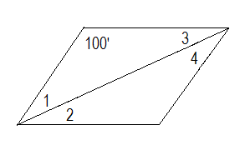
Example #1
Find the angle measures for this rhombus.

Slide 6
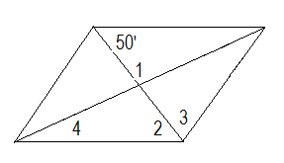
Example #2
Find the angle measures for this rhombus.

Slide 7
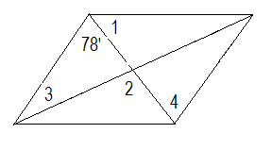
Example #3
Find the angle measures for this rhombus.

Slide 8
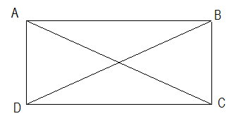
Example #4
Find the length of each diagonal of this rectangle.
AC = 8x + 2
BD = 5x + 11

Slide 9
Practice
WB 6-4 # 1-6, 12, 13, 17, 18
EXIT

